Slide 1
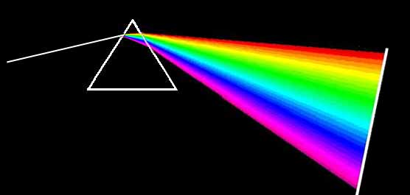
PART 3: VISIBLE LIGHT

Slide 2
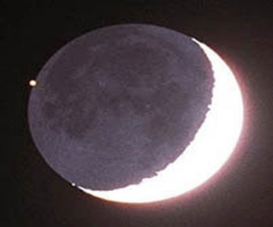
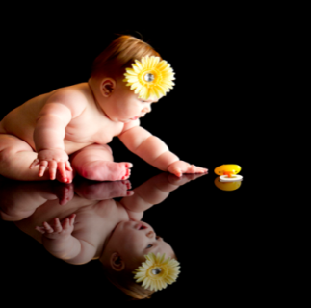
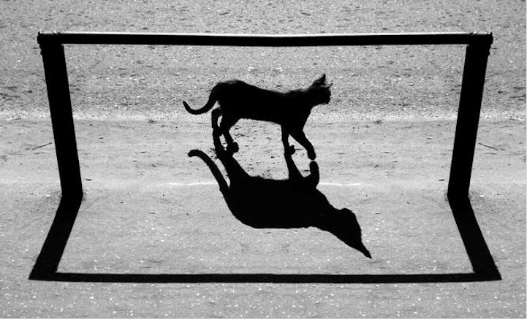
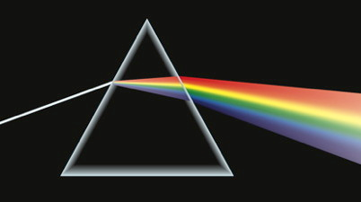
LIGHT
Light is a form of energy that moves in a straight line, at a speed of 300 000 km each second.
It can be produced naturally (sun) or artificially (electricity).
A luminous object sends out its own light (like the sun).
A non-luminous object reflects light (like the moon).
Light can be sent back (reflected) or bent (refracted). It can be absorbed (into coloured objects) or transmitted (glass).
Opaque = blocks light, to make a shadow. Transparent = light moves through it clearly. Translucent = light moves through it, unclearly. (Like the frosted glass in your bathroom.)
Only when light brings a picture into your eye are you able to see anything. Without light, there can be no sight.

